Slide 1
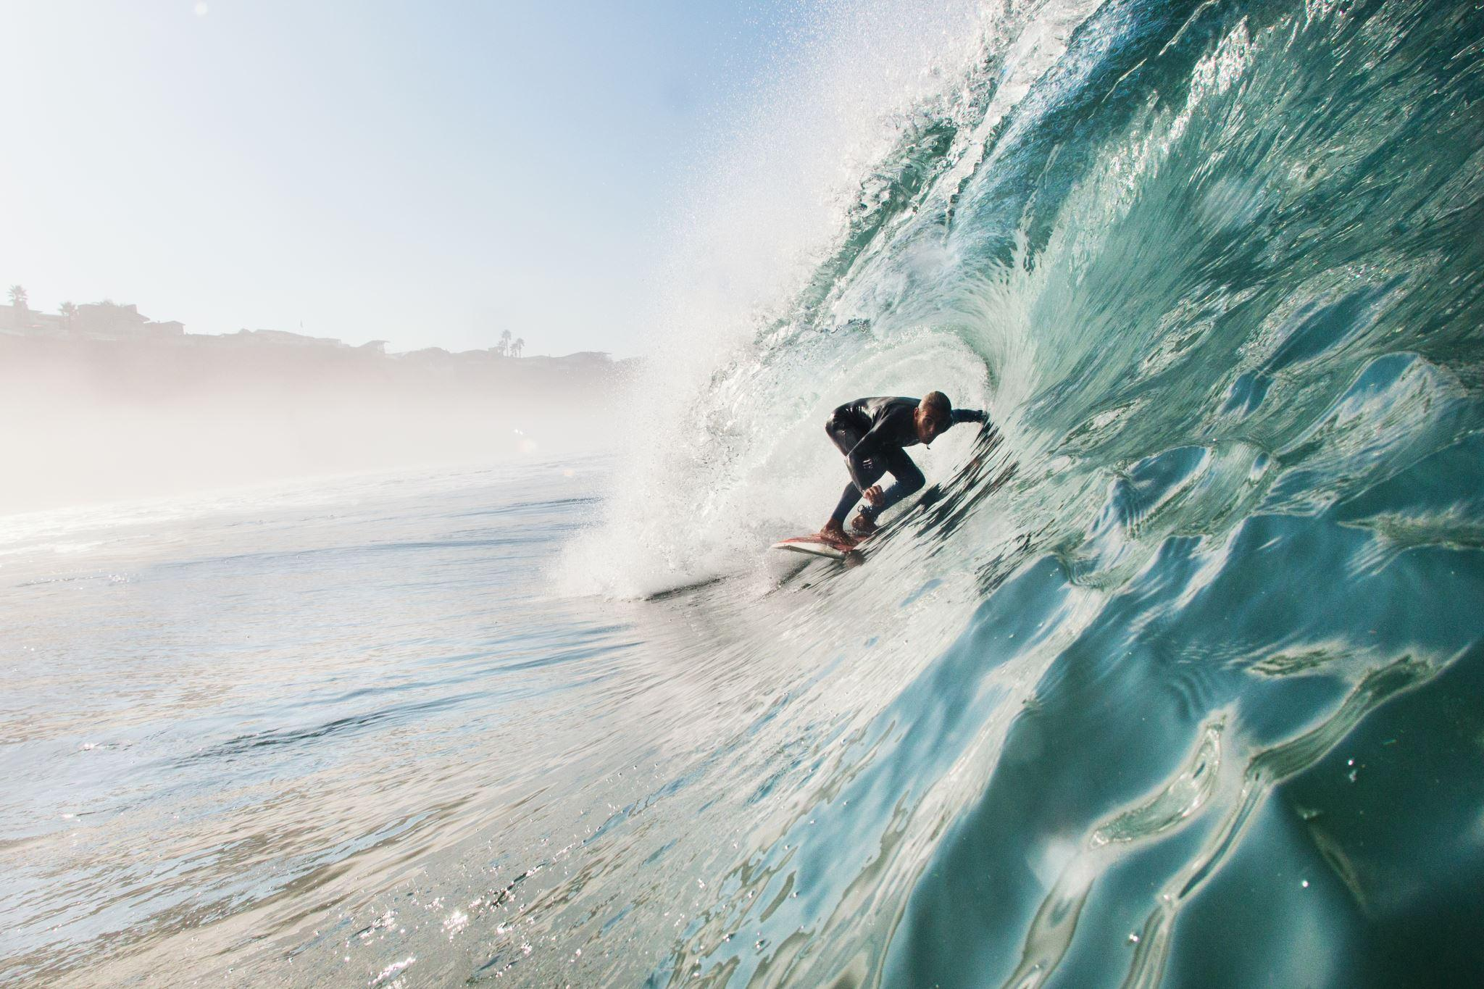
Shark attacks
A bite of advice for safe vacations!

Slide 2
Index
Topic and Target Audience
Data processing
Test Cases
Database Integration
Machine Learning Model
Recommendations

Slide 3
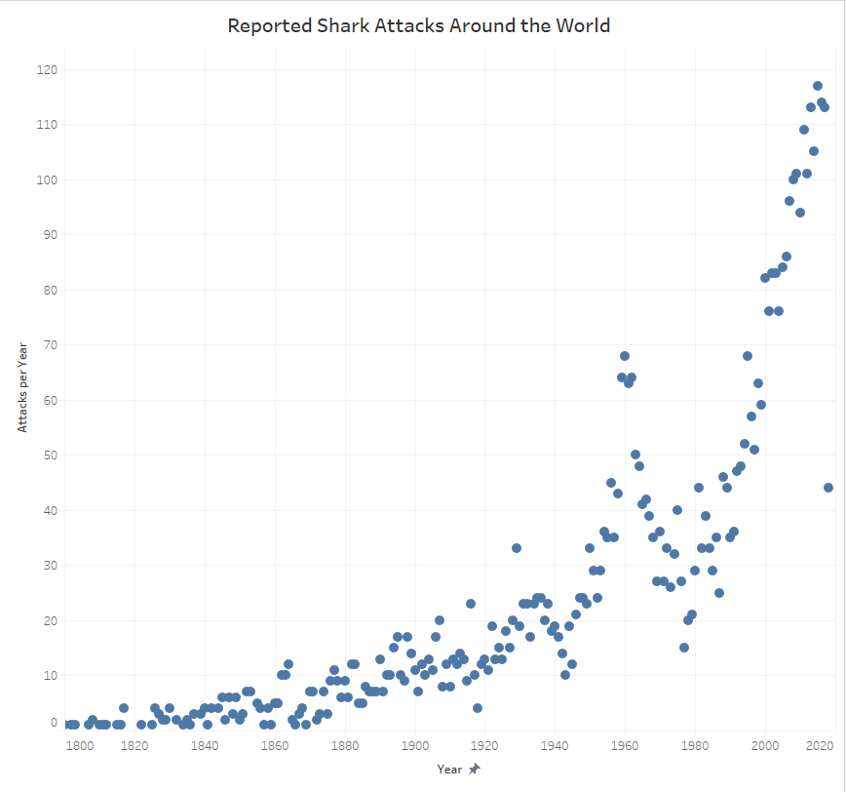
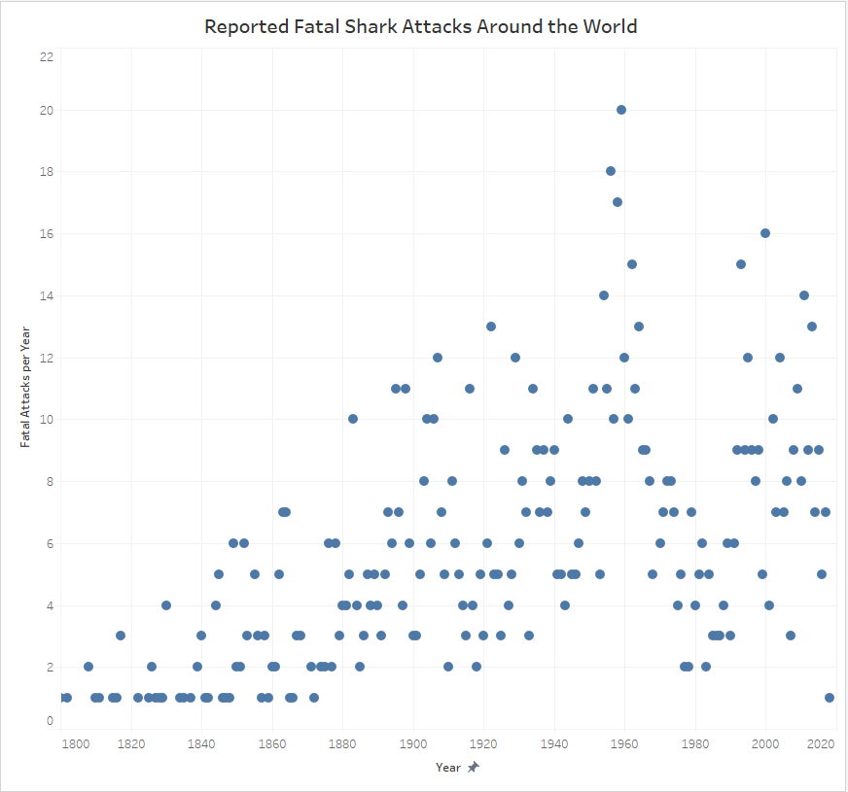
Topic and target audience
There is risk associated with all ocean activities and while the risk of a shark attack is very low, it still occurs fairly frequently.
With this information we hope to increase our customer awareness of the reasons associated with unprovoked shark bites,
Determine which factors contribute toward the attack having a fatal outcome and educate swimmers on ways to reduce their risk of being bitten by a shark.
A graph telling % of people that actually die by a shark attack vs. other causes of death in the water.
How many people are attacked by a shark and how many people actually died from a shark attack

Slide 4
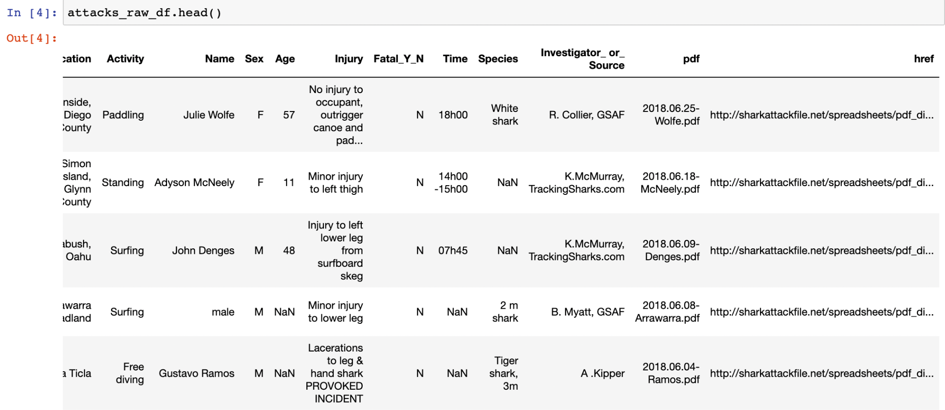
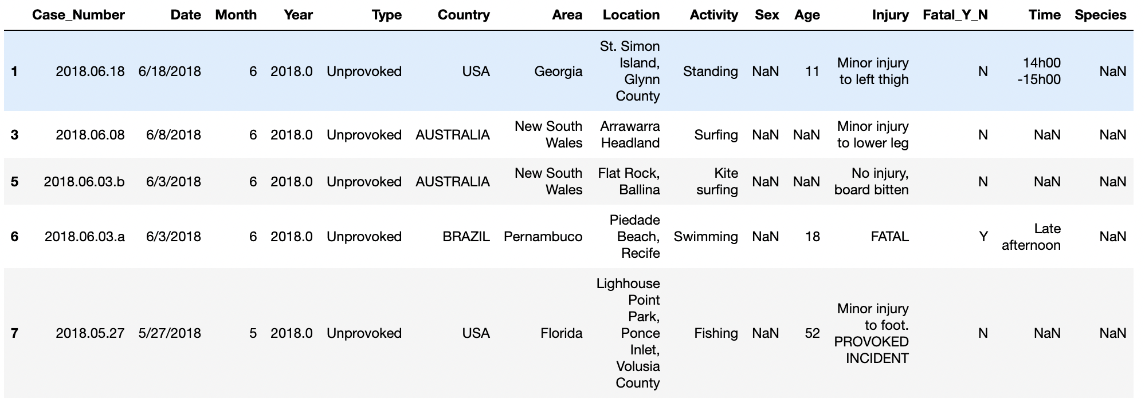
Data processing
Images of the raw data vs. Cleaned data
Image of the data in postgress

Slide 5
Test Cases
Fatality: (Y) Dependent variable
Type: unprovoked
Activities: surfing, swimming, snorkeling/scuba diving, fishing
Locations: area, country
All the features initially suggested
Features for the model after cleaning the data
Main reasons to chose each feature
Fatality: (Y) Dependent variable
Type: unprovoked
Species: Extract size.
Locations: area, country
Fatality: (Y) Dependent variable
Type: unprovoked
Date: Compare the season.
Locations: area, country

Slide 6
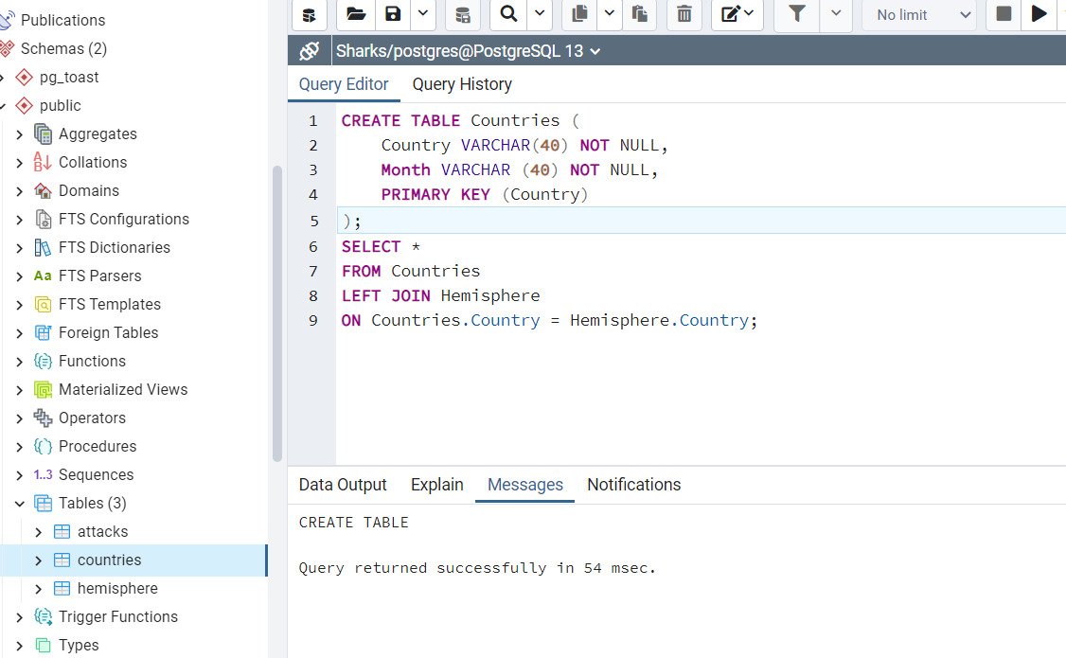
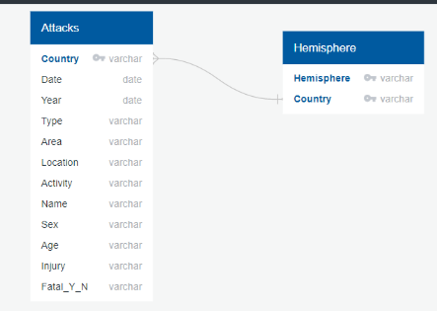
Database Integration
STEPS:
- To clean the Raw attacks dataset in Jupyter Notebook.
Creation of tables in Postgres SQL server: Table attacks and Table hemisphere
To join the two tables by an inner join. The new table will be processed in Jupiter notebook (adding the season feature)
To store the table to be used for the model in the database.
To integrate the database to the model.
- To store the model results in the database.

Slide 7
Machine Learning Model
Regression Analysis to identify significant features
Target: Fatal_y_n
Features: approximately 5
Random Forest Classifier
Confusion matrix

Slide 8
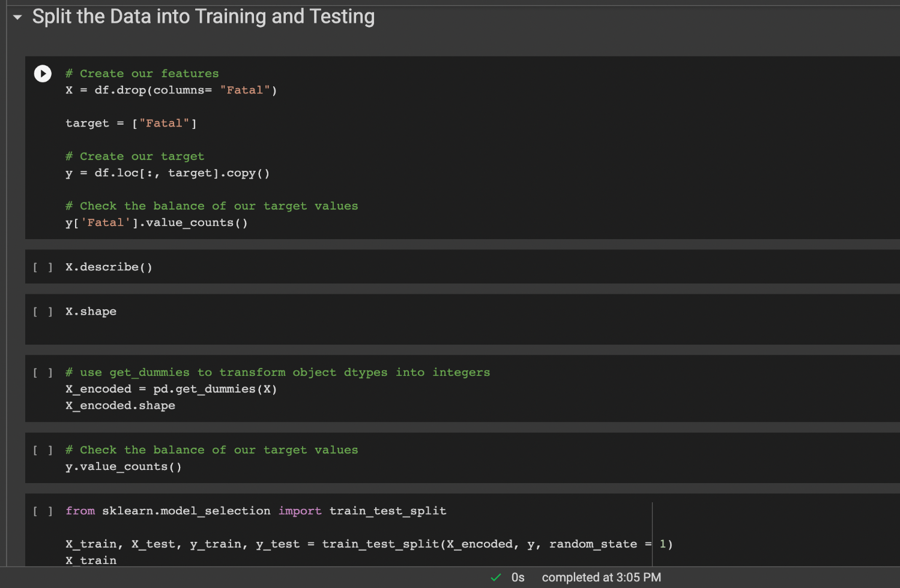
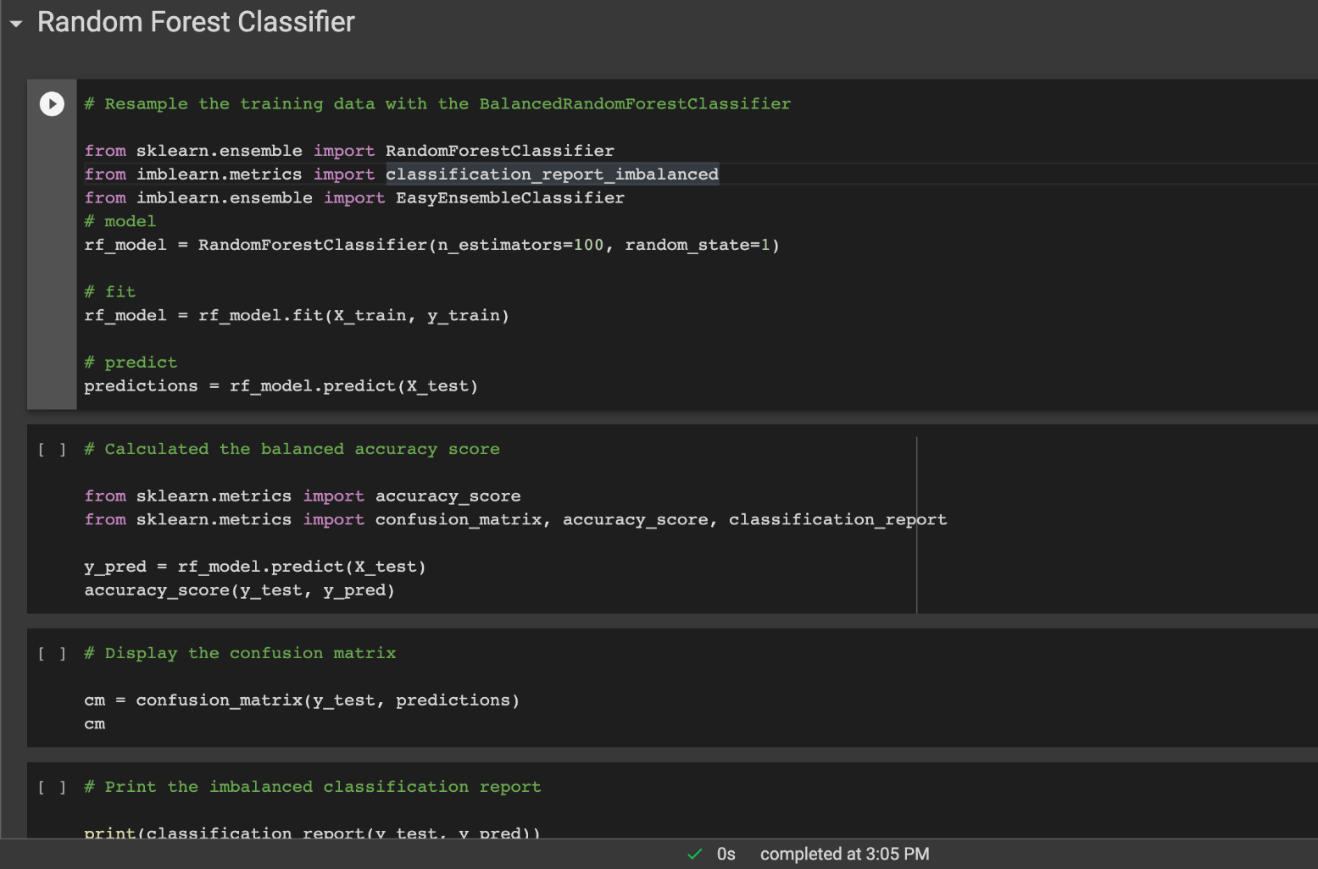
Machine Learning Model
Coding snippets

Slide 9
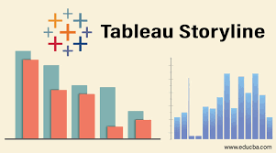
Tableau
Interactive presentation for the customer in a Tableau story
Charts and graphs, using filter options to add interactivity
Pie chart of attacks per water activity
Interactive map/ locations where attacks occur (data permitted)
Table with results from the model

Slide 10
Recommendations
Getting customers to overcome their fears that impact travelling decisions.
Expand our customer base by creating a website to offer our services
What we would have able to accomplish or improve if we would have had more data.
Educate people on how to prevent shark attacks. What are the main contributors of Shark Attacks.
With more data and standardized data documentation more contributors for shark attacks could be identify

Slide 11
Recommendations
To help travel agencies to be able to target their customers who look for adventurous travel experiences with better campaigns based on data
More time and resources that make possible to identify if there are factors related to climate change, migration patterns that impact sharks attacks.

